Slide 1


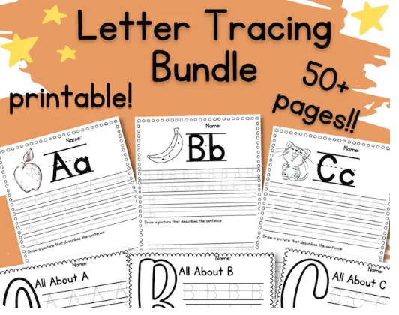



Learn to write your Letter
Learn to Write Your Letters
By Kimberly Cable
Yousof Rahimian
Notes:
Hi, my name is Yousof , and today we will be introducing an application and model to help users learn to write their letters.

Slide 2
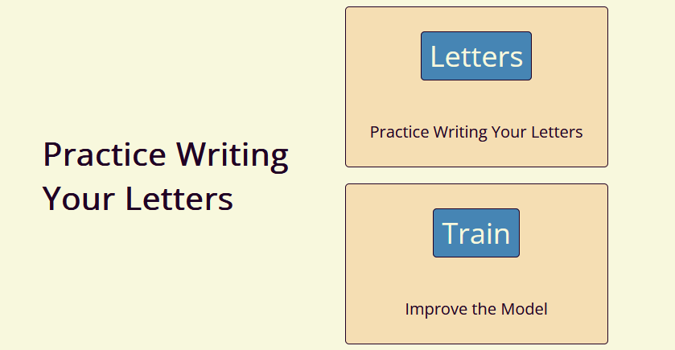
Notes:
Learning to write your letters with a mouse or even your finger is hard for adults as well as children.
This application hopes to help make it easier to write readable letters in the English alphabet.

Slide 3

Data

Slide 4
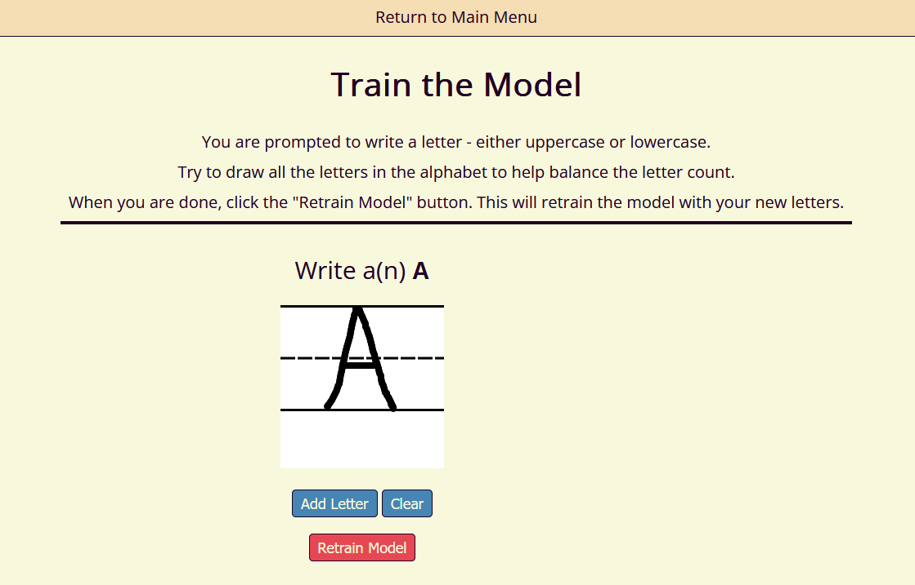
Data
Gathering
Notes:
The Data will be initially gathered from the user.
The user will use the application to write the letters of the alphabet to build the training data for the model.

Slide 5
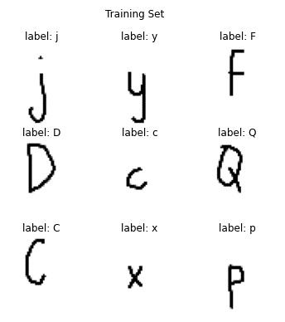
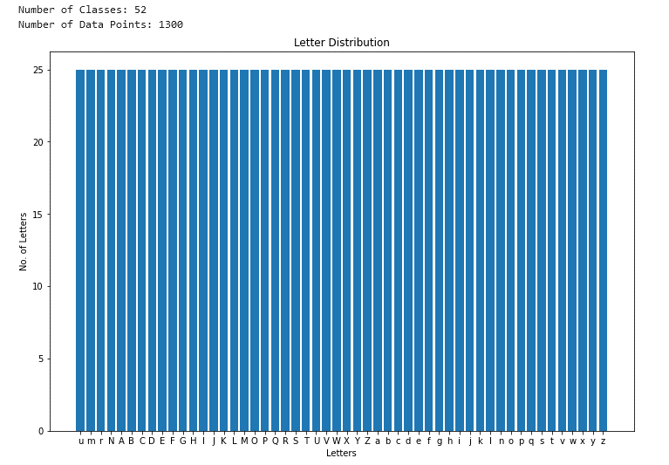
Data
Notes:
The application is also set up to make sure that the dataset is balanced between all the letters.
Here we can see that there are 25 letter images per class. Meaning there are 25 images per upper and lower case of the alphabet.
On the right, you can see an example of what the images look like in the training dataset.

Slide 6
Analysis
Notes:
Now lets look at the model used for analysis

Slide 7
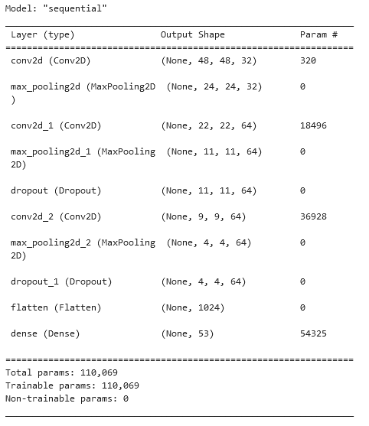
Analysis
Notes:
To predict which letter the user wrote, we used TensorFlow's Keras model with the Sequential class.
We used 3 layers with dropout, and also applied Data Augmentation to generate more training data. Since the application relies on user-provided images, this augmented data helps create diversity by shifting each image 10% in width and height and flipping them.
The augmented data will also improve predictions when users write off to the side instead of using the provided template.

Slide 8
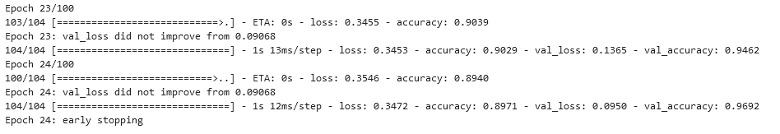
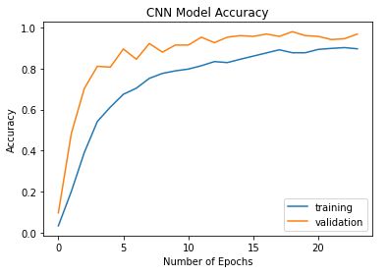
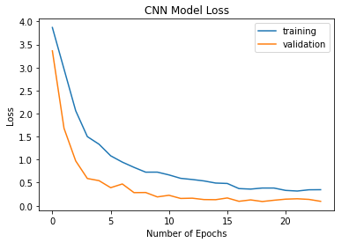
Analysis
Notes:
The model was run with 100 epochs and had early stopping when the validation loss did not improve for 5 epochs.
With this iteration, the model ran 24 epochs, and it achieved a loss of 0.3472 and accuracy of 0.8971. A validation loss of 0.0950 and a validation accuracy of 0.9692.
As you can see by the graphs the validation data did better than the test data and did not overfit making this a pretty good model for the application.

Slide 9
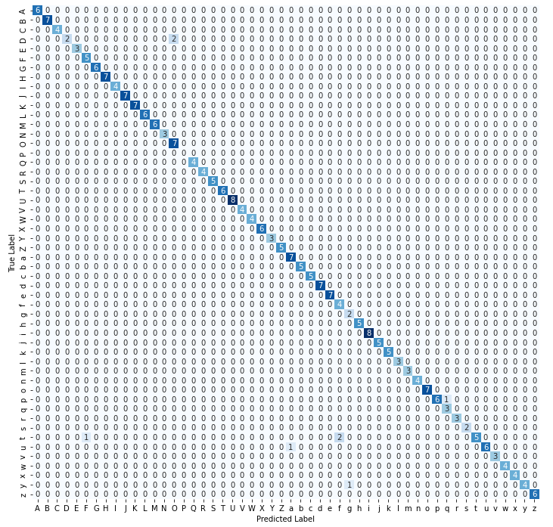
Analysis
Notes:
To evaluate this further, the confusion matrix shows us how each test letter was predicted. Most of the letters did fairly well but as you can see the capital letter D was predicted twice as a capital P but 7 times it was correctly predicted. The small letter t was also predicted as the small letter f.
Looking at both these cases the letters are very similar so its understandable why the model had problems predicting those letters.

Slide 10
Application
Notes:
Now lets look at the application interface for testing

Slide 11
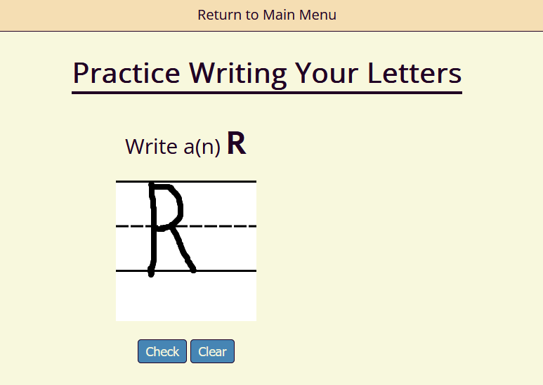
Application Interface
Notes:
The user writes the letter from the prompt. In this case the Letter R

Slide 12
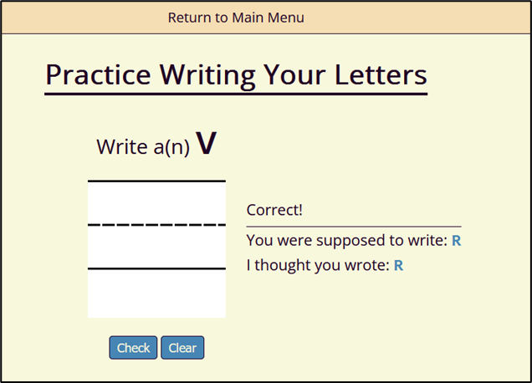
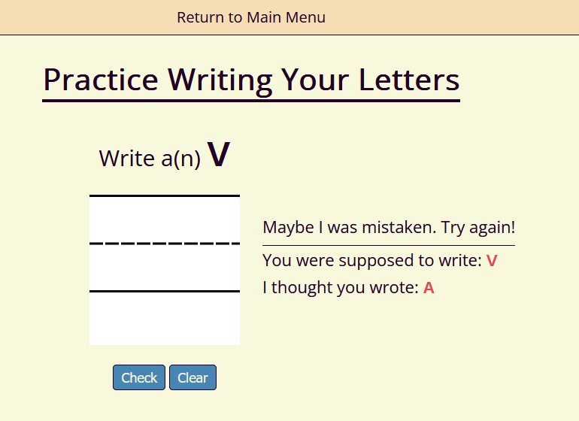
Application Interface
Notes:
If the model predicts the correct letter a Correct message appears and the next letter to write is prompted.
If the model didn’t predict the correct letter a Try Again message appears, and the user has 3 attempts to write the correct letter.

Slide 13
Potential Uses and Upgrades
Notes:
Next let’s look at the potential uses for the application and future upgrades

Slide 14

Future Upgrades
Practice words
Practice short sentences
Practice numbers
Notes:
With future releases, the application will allow you to practice writing combinations of letters into words and then small sentences and eventually will be able to practice writing numbers.

Slide 15

Potential Uses
The possibilities are endless!
Learning to draw
Learning a Foreign Language
שלום
Notes:
The application can also be used to for writing the alphabet of a foreign language or even for learning to draw small images like animals or characters.
The user would just need to input those characters into the training dataset and retrain the model.
With an application like this the possibilities are endless. Its just up to your imagination.

Slide 16

Learn to Write Your Letters
By Yousof Rahimian
Notes:
I hope you’ve enjoyed learning about how to practice writing your letters.
Thank you

